Slide 1
Sensory Organ

Slide 2
Sense organ
These organs which perceive the undergoing changes inside and outside of the body and make the body aware of them is known as sense organ.
Sense organs contain different types of receptor cell or sensory cells. These sensory cell are as follows:

Slide 3
Melanoreceptors: These are responsible for receive tactile stimuli (Touch) and vibration.
Thermoreceptors: These are responsible to receive the heat stimuli.
Chemoreceptors: receive the changes in concentration of chemical substances.
Photoreceptors: receive the changes in the intensity of light.
Phono-receptors: receive the changes in the sound waves.
Gustato receptors: these receptors are responsive to taste.
Olfactory receptors: these receptors are responsible to smell.

Slide 4
Sense Organs of human
Eye: Vision
Ear: Sound
Tongue: Taste
Nose: Smell
Skin: Touch/heat/cold

Slide 5
Eyes
Eye is a photoreceptor organ or the organ of sight. It helps to receive the light & give sense of vision.
There are pair of eye balls in human which are present in the socket of the skull.
Eye lashes & eye lids are the protective covering of the eye balls. There are two types of glands which are present in the eyes of human. i.e. Meiobomian glands & Lachrymal or tear glands.

Slide 6
1. Meiobomian glands:
These are modified form of sebaceous gland, present along with edges of eye lids. It produces oily substances which lubricate eye lids & eye lashes.

Slide 7
2. Lachrymal or tear glands:
These glands are modified form of sweat gland also called tear secreting gland.
These are present on the superior & lateral surfaces of eye ball. Tear contains enzyme lysozyme which helps to kill the foreign micro-organisms & tear also washes the eye balls.

Slide 8
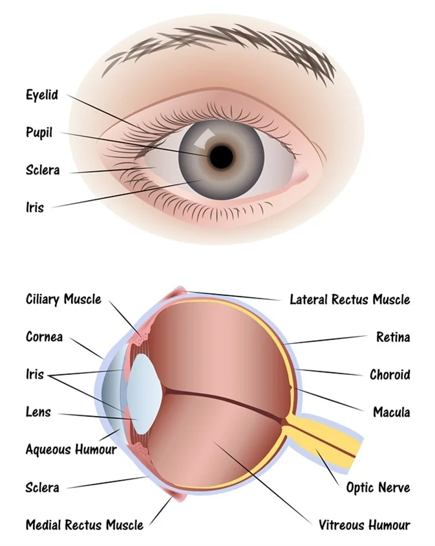

Slide 9
Internal Structure of Eye

Slide 10
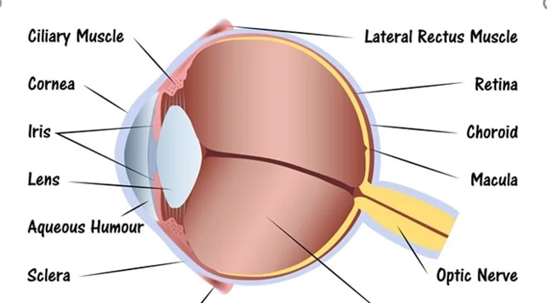
The internal structure of the eyeball consists of the following parts.
Outer coat: It consist of following parts
Sclera: It is an external white part of eyeball. It is made up of fibrous connective tissue. It is tough and opaque part. It occupies about 5/6th part of eye ball. It is protective in function and also maintain shape of the eye ball.
Cornea: It is slightly bulged in front and front part of the eyeball. It is thin and transparent part, through which light enters into the eye. It occupies about 1/6th part of eyeball. It is not supplied with blood vessels and absorbs oxygen directly from the air. It refracts the light rays to focus on the retina.
Conjunctiva: It is a single layer of stratifies squamous epithelial tissue. It is thin and transparent layer that covers and protect the cornea.

Slide 11
2. Middle coat: It consist of three parts
Choroid: It lies just below the sclera. It is thick, highly vascular and pigmented part. It absorbs light and prevent it from being reflected. It makes the internal eyeball dark. It’s function is to provide nutrition and prevent internal reflection of light.
Ciliary body: It lies at the junction between sclera and cornea. It contain ciliary muscles and suspensory ligament. Its function is to hold the lens and to change of lens.
Iris: It is a muscular, pigmented and opaque diaphragm which hangs infront of the lens. A small circular opening between axis is pupil. It permits the light to enter into the eye. The movement of iris muscle control the size of pupil. Iris contain a pigment which is responsible for color of eye.

Slide 12
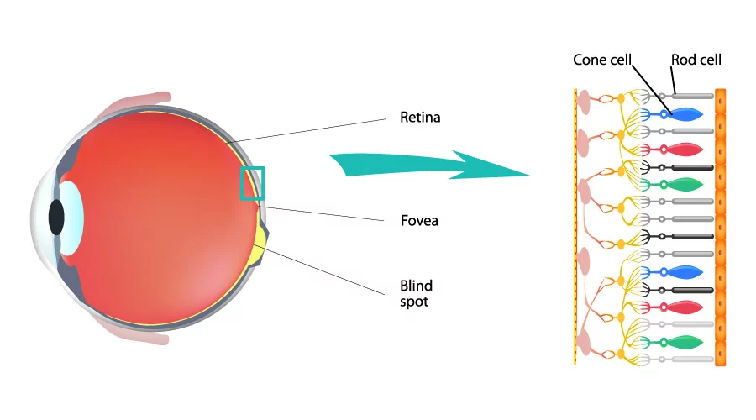
3. Inner coat: It is the photo sensitive layer. It consist of two types of photoreceptor cell that is rods and cones.
Rods:
There are about 110 to 120 million rod on retina they function in dim light and make black-and-white image. It contains a pigment called Rhodopsin. It is formed by Vitamin A (Retinal) and protein (opsin).

Slide 13
b. Cone cells
There are about 7 million cones on retina. They function in bright light and make coloured image (differentiate colour). They contain iodopsin pigment.
The retina has the combination of both rods and cones but there is a small area where only cones are present. This is called a yellow spot (fovea centralis or macula lutea).
This is most sensitive to light and forms sharp and clear images. The optic nerve also enters into the retina at a point where rods and cones are absent called blind spots. It is less sensitive to light and thus no image is formed. (60% red cones, 30% green cones and 10 %blue cones)

Slide 14
4. Lens
It is large flexible, transparent, biconvex and fibrous crystalline part, situated behind the iris. It focus the image of the object on the retina.
Lens separate the eye ball into two chamber.

Slide 15
a. Aqueous chamber
It is a small chamber between cornea and lens. It is filled with clear watery fluid called aqueous humour. It contain amino acid, glucose, vitamins, minerals and respiratory gases. It nourishes the lens to refract the light rays to focus retina.

Slide 16
b. Vitreous chamber
It is large chamber between lens and retina.
It is filled with jelly like fluid called Vitreous humor. It contains salt and some mucoprotein.
It supports the retina and lens. It also refracts light on the retina it also gives shape to the eyeball.

Slide 17
Working of eyes (Image formation)
The cornea, aqueous humour, lens and vitreous humour together form a dioptric apparatus, which help to focus the image of an object on the retina.
When the light rays fall on cornea, pass through the pupil and form image of an objection the retina. Iris controls the amount of light pass through the pupil. Lens adjusts for sharp focusing. The adjustment by the lens is called accommodation.
The image formed on the retina is inverted. The light rays from the object pass through the layers of retina to stimulate rods and cones. The inverted image formed at the retina is picked up by optic nerve as impulses and finally reached to the brain where it is interpreted the real sensation of sight arises finally person perceives the object as upright way.

Slide 19
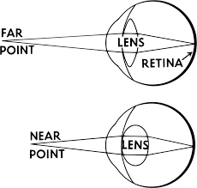
Accommodation
It is the adjustment of the shape of the lens to focus the light ray on the retina coming from various distances.

Slide 20
Defects of eyes
Hypermetropia (far-sightedness) : It is occur when the eye ball is closer to the lens. It can be corrected by using the convex lens. (close object- rays go far from retina)
Myopia (Short-sightedness): It occurs when retina is far from lens. It can be corrected by using concave lens. (far object- no rays reached to retina)
Astigination: It is due to the difference in the curvature in the different meridians of the refractive surface of the eye. It is corrected by using a cylindrical lens. (unequal vision)
Cataract (Moti bindu): It is due to the lens becoming opaque because of the clotting of protein. It is corrected by surgical removal of the opaque lens and replaced by an artificial lens. (white in color)

Slide 21
5. Glaucoma (jalbindu): It is due to closure of canal of schlemm increases the intraocular pressure of the eye (in aqueous chamber) and causes glaucoma. In this diseases optic nerve get damaged and visual cells die. Finally person become blind. It is cured by operation at early stage. (black)
6. Presbyopia: It is defect in accommodation occurring in old age. In this defects, lens does not focus the image near object and far objects. It is corrected by using a bifocal lens. (old age)
7. Conjunctivitis: It is also called pink eye. It is an inflammation of the conjunctiva.
8. Trachoma: It is the redness of eyes. It is a chronic stage of connectivities and caused due to an infection of a bacterium called Chlamydia trachometis.

Slide 22
Ear
Ear are situated on either side of head. It consist of three parts:
External Part: It is outer part and made up of two parts.
Pinna: It is cup shaped part of ear. It is made up of elastic cartilage. In man, it is immovable due to vestigial ear muscles.
Auditory canal (auditory meatus): Pinna opens into 2.5cm long narrow tube called auditory canal. It’s outer hairy part prevents the entry of dust particles. It’s inner part contain ceruminous gland (Wax gland) which secretes earwax that prevents the entry of foreign body (insects).

Slide 24
2. Middle Ear (Tympanic membrane and tympanic cavity)
It is a air filled chamber present outside the temporal bone called tympanic cavity. It is connected with pharynx by a narrow duct called Eustachian tube.
It help to keep equal air pressure on both side of the tympanic membrane (Ear drum). Eardrum is a thick oval, stretchable membrane which separates external ear from middle ear.
The tympanic cavity or middle ear contain three smallest bone called ear-ossicles. These ear ossicles connected to each other by a ligaments and muscles. These ossicles conduct sound waves from external to internal bar.
These ear ossicles contain three bones i.e. Malleus, Incus & Stapes.
Malleus: - hammer – shaped attached to ear drum.
Incus: - anvil- shaped, lies between malleus & stapes.
Stapes: - Stirrup shaped, attached to fenestra ovalis.
(notes: 20 times more sound increases in ossicles )

Slide 26
Internal ear: (notes: bony labyrinth) Internal ear is differentiated into three parts.
Vestibule: It is the sac of the membrane which has two sac i.e. larger utriculus and smaller sacculus. These two sacs connected by the utricular-saccular duct. Internally both the utriculus and sacculus contain a sensory, spot called the macula, which is concerned with balancing the body during stationary conditions.
Semi-circular canal: These are the three sem-circular canals, born over utriculus. They are anterior, posterior and horizontal canals. One end of each semi-circular canal is swollen to form an ampulla. Ampulla contains a sensory spot known as a crista. Crista is concerned with balancing the body during dynamic conditions.
Cochlea: It is the main hearing organ. It is spirally coiled tube of about 20-30mm long. It arise from sacculus. Cohlea consists of three fluid filled chamber (Scala vestibule, Scala tympani and Scala media).

Slide 27
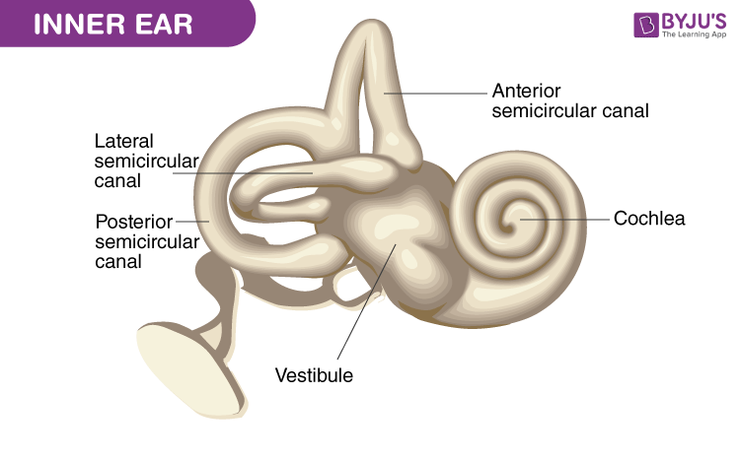

Slide 28
Function of Ear: Ear have dual functions of hearing & maintaining equilibrium of body.
a. Hearing: During hearing sound waves from the external environment strike to eardrum, which is capable of vibrating. These vibrations pass through the 3 ear ossicles (malleus, incus and stapes) into the inner ear. Sound waves are picked up by the scala vestibule of the cochlea from the stapes through the fenestra ovalis. The vibration of the perilymph in the scala vestibule causes to vibrate of the Reissner's membranes of the scala media. Scala media contains a special type of fluid called endolymph; movement of endolymph is caused by the vibration of Reissner’s membrane. Sound waves are collected by the auditory cells of the organ of corti which are present in the basilar membrane. Auditory cells change the sound waves into nerve impulses & pass them to the brain through auditory nerves for hearing.

Slide 30
b. Equilibrium: Human ear can detect 2 types of equilibrium i.e. dynamic equilibrium & static equilibrium.
Dynamic Equilibrium: It is caused by the rotational movement of the body which is detected by the cristae of the ampulla which is present in the semicircular canal.
Static equilibrium: It is caused by the linear motion of the body which is detected by the maculae of the utriculus & sacculus of the inner ear & passes to the brain in the form of nerve impulses through the auditory nerve.

