Slide 1
Protista

Slide 2
Protista
It is a kingdom of eukaryotic, unicellular, Microscopic organisms. It is classified into three groups,
a) photosynthetic protistians
b) protozoans protistians
c)Slime Moulds Protistions

Slide 3
→ Photosynthetic protistans
They are algae like protistians as their mode of nutrition is photosynthetic. Examples: Euglena, golden brown algae etc.

Slide 4
→protozoans protistans
They are simple acellular or unicellular organisms and their body is naked or covered by pellicle.
They have locomotory organelles like pseudopodia, cilia or flagella while in some, locomotory organelles are absent.
Nutrition may be Holozoic (animal like) Saprozoic (feed on the decomposed matter) or parasitic ( derive food from hosts).
Respiration and excretion occurs through general body surface by diffusion. But in some excretion occurs through a temporary opening or through a permanent pore called cytopyge.
Asexual reproduction occurs by binary and multiple fission, budding or sporulation and sexual reproduction takes place by conjugation.

Slide 5
Slime moulds protistans (Myxomy cophyta)
They have the characteristics of both - animals and fungi and hence called protistans fungi.
They are terrestrial and occurs in cool, moist and shady in decaying organic matter.
They lack cell wall, hence it has indefinite cell.
They usually occur as free-living multi-nucleate, the amoeboid mass of protoplasm in the form of slimy mass, so called slime Moulds.

Slide 6
Classification of protozoa
1) Class 1 Rhizopoda
The locomotary organelle is pseudopodia.
The body is covered with plasma- lemma.
Body shape is Irregular.
Free-living or parasitic
Nutrition is Holozoic or saprozoic
Eg.- Amoeba, Entamoeba.

Slide 7
2. Class 2 (Ciliata)
Locomotary organelle is hair-like cilia.
Body with definite pellicle, so the body shape is fixed.
Dimorphic nuclei ie. large macronucleus nucleus and small micro- nucleus.
One or more contractile vacuole.
Free living or parasitic.
Eg. paramecium, vorticella.

Slide 8
3. Class 3 ( Flagellata)
Locomotary organelle is flagella.
Body with definite thin pellicle.
Nutrition autotrophic or heterotrophic or both.
Free Living or parasitic.
Eg. Euglena, Trypanosoma.

Slide 9
4) Class 4 ( sporozoa)
Locomotory organelle is absent.
They are exclusively endo-parasite.
Contractile vacuole is absent.
Asexual reproduction occurs by spores.
Example: plasmodium

Slide 10
Paramecium
Systematic Position (classification)
kingdom: Protista
Phylum: protozoa
Sub phylum: Ciliophora
Class: Ciliata
Genus: Paramecium
Species- caudatum

Slide 11
It is a Microscopic organisms.
It is the typical ciliata.
Ciliates are characterized by the presence of cilia nuclear dimorphism and unique type of reproduction.

Slide 12
Habit and Habitat
It is a fresh water unicellular ciliate which Inhabitat in ponds ditches, rivers, rice-field etc.
It is abundantly found in Stagnant water where organic matter is plenty.
It moves here and there with the help of cilia.
Cilia also function for capturing food.

Slide 13
Structure
Their body is streamlined.
Their anterior end is blunt and circular while the posterior end is thicker and pointed.
Shape and size
It is slipper-shaped so, it is commonly known as slipper animalcule.
It is about 0.06mm- 0.3mm long

Slide 14
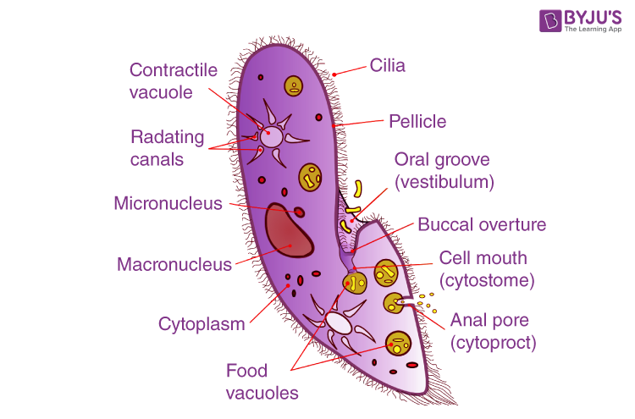
# External structure of paramecium
pellicle
The whole body is covered by or a thin and flexible membrane called pellicle
2) Cilia
The pellicle is covered by a Small hair like structure cilla. They are Locomotory organ and also help to capture the prey.

Slide 15
3. Oral Groove
There is a depression on the antero-ventral side of the body which is called oral groove.
It leads to circular mouth known as cytosome which opens into a funnel like structure called cytopharynx.

Slide 16
4. Cytopyge
On the ventral surface just behind the cytopharynx, there is a minute permanent cell opening in the pellicle called as cytopyge, through which undigested food particles is excreted out.

Slide 17
Internal structure of paramecium
The cytoplasm of paramecium is divided into two parts i.e. narrow external part called ectoplasm and a large inner part is called endoplasm.
Ectoplasm: It is a dense, transparent outer layer part of cytoplasm in contact with the pellicle. It consist of trichocysts, cilia and is bounded externally by pellicle.

Slide 18
i. Trichocysts
It is a small spindle shaped, bag like Structure located in the alternate with bases of cilia.
These are the defensive organs of paramecium.
It releases thread like structure called spikes, When they are stimulate by mechanical or chemical means.
Discharge of spike helps in escaping from enemy and it also helps in anchoring ( to support). Thus, they act as a defensive and adhesive organ.

Slide 19
2. Endoplasm
It is inner layer of cytoplasm which is thin granular structure. consist of following parts:
Contractile vacuole
In endoplasm, there are two star shaped contractile vacuole, each consist of 6-10 radial canals, absorbs excess water and carry it into the central vacuole. When the central vacuole is filled, it opens out side through pellicle and thus, water spells out. This phenomenon in which excess water is removed by the process of Osmosis, is called osmoregulation.

Slide 20
b) Nucleus → In paramecium, there are two types of nucleus. The large kidney-shaped nucleus is known as the macro-nucleus, which controls, general cellular activities like respiration, digestion, excretion etc. The small or round nucleus is called micro nucleus, which controls reproductive activities.

Slide 21
c) Food vacuoles:
They are formed at the tip of cytopharynx.
There are many food vacuoles inside the endoplasm and they help in circulation, digestion, absorption and elimination of food materials.

Slide 22
Reproduction of paramecium -
Two types of Reproduction takes place in paramecium, they are:-
Asexual reproduction
If the reproduction takes place without fusion of gametes then it is said to be asexual reproduction. Paramecium usually takes place through this reproduction during favorable conditions i.e. when the food is sufficient. It takes place through transverse binary fission.

Slide 23
Transverse binary fission
It is completed into following steps:
First of all, paramecium stops feeding and attach to the substratum.
Cilia and oral groove becomes dis-functional and gradually disappears
The Micro- nucleus elongates and constrict and proceeds through Mitotic division.
Similarly, Macro nucleus elongates gradually, constrict at the Middle and proceed through amitotic division.
A dividing constriction develops the middle of the mother's body which progressively deepens inside.
Each contractile vacuole divides unequally into two, the smaller daughter vacuoles move apart towards the center.
Their is an appearance of oral groove one in the anterior half and the other in the posterior half.
Now, the gradually elongating micro and macronuclei constrict transversely at the middle and then each divides into two daughter nuclei.
Now the constriction follow further deepens inside until the cytoplasm is completely divided into two equal halves.
Thus, two daughter paramecia, of equal size and the complete set of all organelles are formed. One formed from the anterior side is protex and the other formed from the posterior side is opisthe

Slide 24
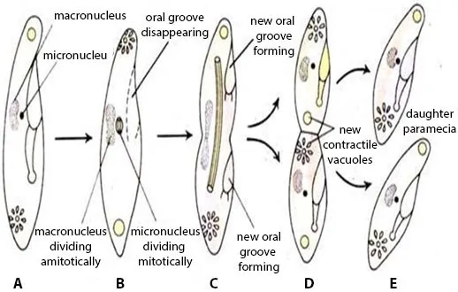

Slide 25
Sexual reproduction
It reproduce sexually by nuclear reorganization such as conjugation, autogamy etc.
1. Conjugation:
If reproduction occur only during unfavorable condition on when failure to undergo transverse binary fission.
It is the sexual process in which two individuals temporary adhere and exchange their nuclear materials. During this process following events occurs:
i) The two paramecium comes close to each other and get attached from the side of oral grooves by some sticky substances. The paramecium that takes part in conjugation are called conjugant.
ii) At the point of attachment pellicle degenerates to form a cytoplasmic bridge.

Slide 26
iii) After the formation of the cytoplasmic bridge, the macronucleus of each conjugant starts to disappear.
iv) The micronucleus undergo meiosis division, forming four nuclei in each conjugant.
v) In each conjugant, out of four nuclei, 3 nuclei degenerates and only one remain functional.
vi) The remaining one functional nucleus undergoes mitotic cell division, to produce two nuclei, one is larger and another is smaller in shape.
vii) Smaller nucleus at each conjugant migrates, although the cytoplasmic bridge, which is called the migratory nucleus or male pronucleus and larger nuclei remains stationary, which is Called female pronucleus.
viii) Now, male pronucleus fuses with female pronucleus and forms zygote in each conjugant.

Slide 27
ix) Now, two paramecium separate from each other and are called exconjugants.
x) In each conjugant, the zygote undergoes three mitotic division to produce 8 nuclei
xi) Out of 8 nuclei, 4 become larger called macronuclei and 4 become smaller called micronuclei.
xii) Out of four micronuclei 3 degenerates and one remains functional.
xiii) The functional Micronuclei in each conjugant divide into two. And two conjugants are divided by binary fission into two daughter paramecium. Again the micronuclei of two daughter paramecium divided into two having one macro and one Micronucleus and later paramecium divide again produce 8 paramecium.

Slide 28
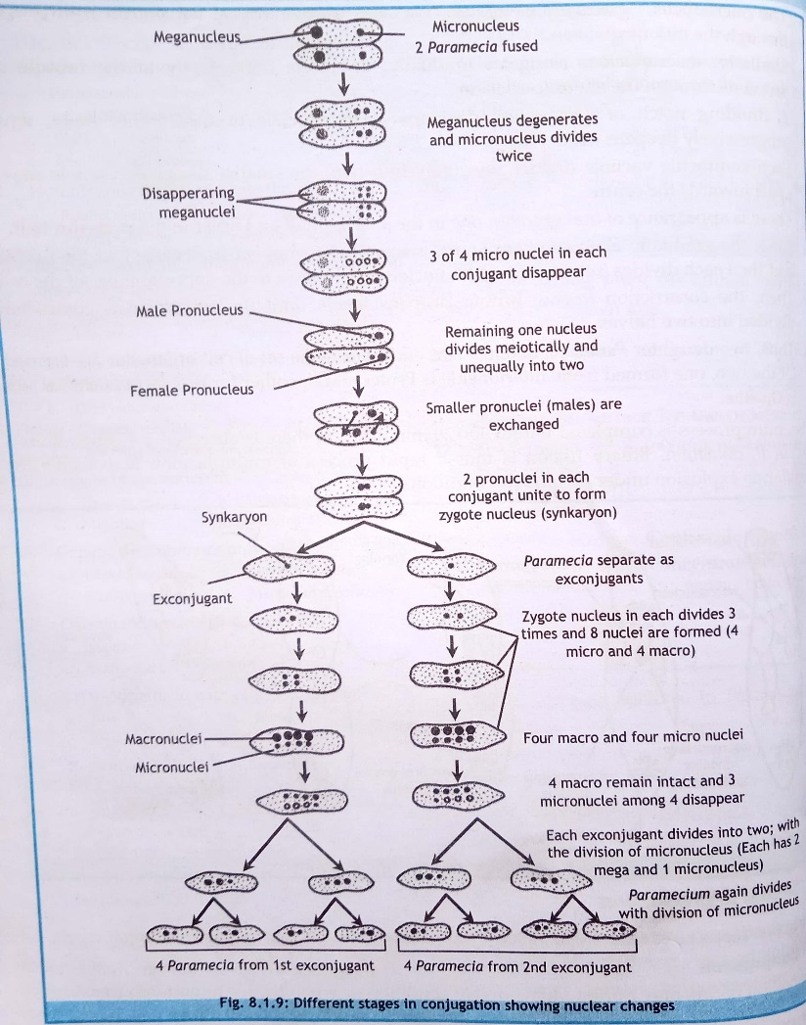

Slide 29
Significance of conjugation
a) Rejuvenation
Due to conjugation, a weak and old paramecium becomes young, viable. and energetic.
b) Immortality - Due to conjugation, there is no natural death of рагamecium forever. Therefore, paramecium never gets old.
c) Genetic vigour and adaptability
Mutual transfer of hereditary materials between conjugates brings about useful variations in their progeny suitable for the new and changing environment.

Slide 30
2. Autogamy
It is a sexual reproduction in which conjugation takes place without exchange of nuclei between two conjugants instead fusion of two nuclei of same individual takes place.

Slide 31
3. Cytogamy
Cytogamy is also considered as a sexual reproduction. In this method the whole process resembles conjugation but in this type of reproduction, the fusion of male and female pro-nuclei of the same conjugant takes place instead of exchange of male pronuclei between two conjugants.

Slide 32
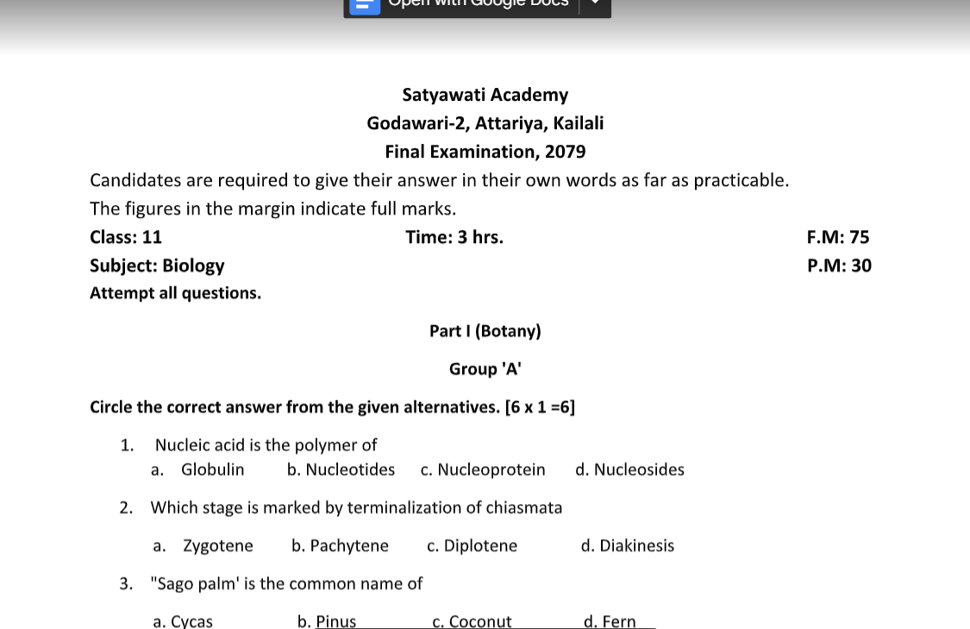

Slide 33
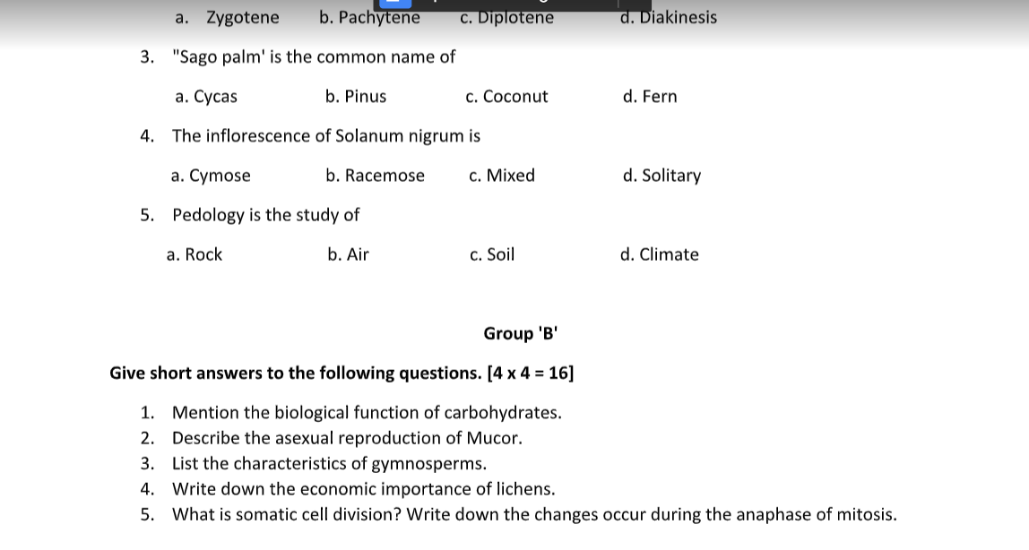

Slide 34
