Slide 1
Digestive system of human being

Slide 2
The digestive system consists of digestive organ and their working mechanism or physiology of digestion.
In human digestive system involves the alimentary canal and associated digestive glands like the liver pancreas etc.

Slide 3
A. Alimentary canal
It is a long and coiled duct extending bounded from mouth to the anus.
It measures about 8-10 m in length and differentiated into the following parts.

Slide 4
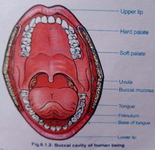
a. Mouth and mouth cavity
Mouth is a transverse aperture bounded by fleshy lips.
Mouth open into wide cavity called mouth cavity or oral cavity.
It is bounded by upper lower jaw and sides by cheeks.
The roof of the mouth cavity is called palate.
From the soft palate, finger like projection hangs down called uvula.
It separates the mouth cavity from pharynx.
Floor of the mouth cavity contain highly muscular tongue and it helps in mastication of food.
Sides of the mouth cavity contain teeth which also helps in mastication of food.

Slide 5
b. Pharynx
Mouth cavity open into the short and narrow duct called pharynx.
It is the common duct for food and air.
It is about 5 inches long, lined with the membrane. It is divided into three parts: nasopharynx, oropharynx and laryngopharynx.

Slide 6
Nasopharynx: Nasopharynx is the upper part of the pharynx which connect nasal passages to Oropharynx.
ii. Oropharynx : oropharynx is the middle chamber of the pharynx that passes food from the mouth into the laryngopharynx.
iii. Laryngopharynx: It is the lower part of the pharynx. It consists of two openings: air opening (glottis) and food opening (gullet). Both opening are separated by the flap of elastic cartilage, epiglottis which covers the glottis so that food cannot enter into the trachea.

Slide 7
c. Oesophagus
The oesophagus or food pipe is a long narrow muscular tube measuring about 25cm.
It is extended from pharynx to the stomach.
It conducts food from the pharynx to the stomach by peristalsis.

Slide 8
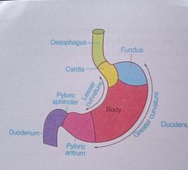
d. Stomach
It is a large J-shaped bag. It is also measured 25 cm in length. It is situated on the left side of upper abdomen.
Stomach is divided into three parts. The upper part is called fundus part, middle and broad part is called body part and the lower and narrow part nearest to the duodenum is called pyloric part.
Wall of stomach contain gastric glands which secrete gastric juice in the stomach.
Food is stored for the long time and digested with the help of churning movement and gastric juice.
The stomach has two opening the entrance (cardiac sphincter) and exist (pyloric sphincter).

Slide 9
e. Small Intestine
The stomach open into small intestine through pyloric sphincter (constriction).
Small intestine is the longest and narrow part of alimentary canal.
It measures about 6.5m length and differentiated into three parts: duodenum, jejunum and ileum.

Slide 10
i. Duodenum
It is the first c-shaped curved tube measures about 25 cm length.
It receive the bile from the gall bladder and pancreatic juice from the pancreas. In the duodenum, maximum amount of food is digested by the help of both bile and pancreatic juice.
Hence it is called principle part of digestion.

Slide 11
ii. Jejunum
It is about 2.5m long coiled duct. It’s internal wall contain thick walled villi not for absorption. Jejunum conduct food from duodenum to ileum.

Slide 12
c. Ileum.
It is the longest and highly coiled part of the small intestine. It is about 3.5m in length. It’s inner wall contain thick walled finger like projection and maximum amount of food absorbed in this part.

Slide 13
f. Large intestine
It is shorter but wider than small intestine. It measures about 1.5m in length. It is divided into three parts:
Caecum
Colon
rectum

Slide 15
i. Caecum
It is the first pouch-like structure which is about 6cm in diameter.
It is connected to the ileum by the ileocaecal junction.
In human, caecum contains 5-10cm long blind tube called vermiform appendix.
In human, it is vestigial but functional only in herbivores.

Slide 16
ii. Colon
It is an inverted U-shaped tube that measures about 1.2m.
It is differentiated into four parts: i.e. ascending transverse, descending and sigmoid colon.
The wall of the colon is constricted at different regions to form pouch-like haustra.
Colon helps in the formation of stool by the absorption of water.

Slide 17
iii. Rectum
The colon finally opens into the rectum. It is a muscular and straight terminal part measuring 15cm.
It leads outside through the anus. The terminal anal opening is guarded anal sphincters.

Slide 18
B. Digestive glands
These glans are associated with digestion of food and pour their secretion into the alimentary canal. These are:
Salivary glands
Pancreas
Liver
Gastric glands
Intestinal glands

Slide 19
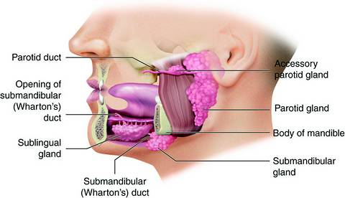
1. Salivary glands
There are three pairs of salivary glands (Parotid gland, Submandibular gland and sublingual gland) which release saliva in the oral cavity.
A normal person secrete 1-1.5 lt. saliva per day.

Slide 20
Functions of saliva
It contains salivary amylase and break down the starch into maltose.
It keeps the mouth moist and cleans the teeth
It lubricate and make moist the food which help for easy swallowing.
It kills micro-organism associated with food.

Slide 21
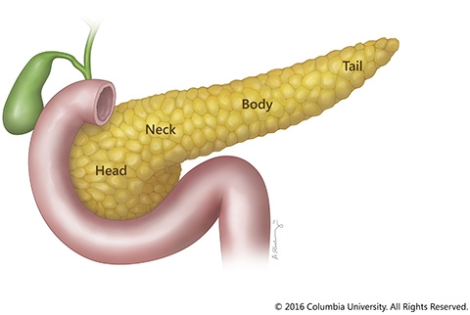
2. Pancreas
Pancreas is a pale grey leaf like gland weighing 60-75 grams.
It is the main digestive gland and present in between stomach and duodenum.
It secrets pancreatic juice.

Slide 22
Functions of pancreatic juice
The pancreas performs two main functions: Exocrine function and Endocrine function.
i. Exocrine pancreas: The pancreas secrete all types of enzymes and digest the all types of food. These enzymes and there functions are as follows:
a. Trypsin: Protein breakdown Amino acid
b. Amylase: Starch Maltose
c. Lipase: Fat Fatty acid

Slide 23
ii. Endocrine functions
Endocrine pancreas secrete two types of hormones : Insulin and Glucagon
Insulin: It is secreted by B-cell. It helps to convert excess glucose into glycogen and reduce blood sugar level.
Glucagon: It is secreted by ἁ - cell. It increases the sugar level by the conversion of glycogen into glycogen into glucose. It is secreted only when sugar is decreased.

Slide 24
3. Liver
It is the largest gland in the body weighing between 1 to 2.3 kg. It is situated just above the stomach, below the diaphragm on the upper abdominal cavity. It is dark red in color.
Liver of human is divided into four lobes i.e. right, left, quadrate and caudate lobe.
Each lobe of liver consists of a large number of lobules formed by hepatic cells. The lobules are branches of the hepatic artery, hepatic portal vein and bile duct.
The hepatic vein connected to the hepatic artery and hepatic portal vein by sinusoids- blood spaces.
The sinusoids alternate with bile canaliculi.
Kupffer cells are found attached to the walls of the sinusoids they are phagocytic in nature and are involved in the breakdown of old RBC and ingestion of harmful bacteria.

Slide 25
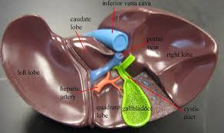

Slide 26
Functions of Liver
1.Functions of bile juice
It secrete bile juice. It is an alkaline juice and neutralize the acidity of chyme.
It emulsify the fat into fat droplets.

Slide 27
2. Metabolic function
Glycogenesis: Conversion of excess glucose into glycogen with the help of insulin is known as glycogenesis
Glycogenolysis: It is the conversion of glycogen into glucose by the liver cells with the help of glucagon hormone released by pancreas.
Gluconeogenesis: It is the formation of glucose and glycogen from non-carbohydrate sources such as amino acids, fatty acids, fatty acids, etc.
Fat metabolism: The liver cells convert the excess glucose and amino acids into fats

Slide 28
3. Protective function
The Kupffer cells of liver engulf microorganisms and other foreign materials.
Liver converts the toxic substances into harmless substances
Liver cells convert the highly toxic ammonia into less toxic urea.

Slide 29
4. Hematological functions
a. Synthesis of RBC and blood proteins
b. Secretion of heparin which is an anti-coagulant
c. Destruction of old RBC

Slide 30
4. Gastric glands
It is present in the wall of stomach. It is branched tubular gland. It secrete gastric juice. A normal person secretes about 2-3 lt. gastric juice daily.

Slide 31
Function of gastric juice
a. HCL
It makes the food acidic.
It activates the inactive pepsinogen to pepsin and prorennin to rennin.
It destroy bacteria and microbes present in the food.
It destroy the hard substances like bone.
It controls the opening of pyloric aperture.

Slide 32
b. pepsin: It breakdown the protein into peptones and proteases.
c. Rennin: It converts the milk into curd. It is only secreted in children.
d. Gastric lipase: It breakdown the fat into fatty acid.
e. Mucus: It protect the stomach wall from the acidic effect of HCL and also make food slippery.

Slide 33
5. Intestinal gland
It is present on the wall of jejunum and ileum.
It is of two types: Crypts of lieberkuhn and Brunner’s glands.
Crypts of Lieberkuhn produces hormones and brunner’s glands produce enzymes and mucus.

Slide 34
Physiology of digestion in human
The physiology of digestion in humans completed in the following steps:
Ingestion: It is the process of taking of food into mouth
Digestion: It is the conversion of complex food into simplest. Digestion of food is a physical and chemical process. In the physical process, large food is broken into smaller forms. In a chemical process, large molecules of complex food are broken down into simple molecules. In human, digestion begins from the mouth cavity and ends at the ileum part of the intestine.

Slide 35
a. Digestion in mouth cavity
In the mouth cavity, food is digested by both physical and chemical processes. The tongue and teeth digest food physically into smaller pieces.
The saliva secreted by salivary glands makes the food moist and slippery for easy swallowing.
Saliva contain an enzyme “salivary amylase” and it digest starch into maltose.

Slide 36
d. Digestion in stomach
From mouth cavity, food is transported to stomach through pharynx and oesophagus.
In the stomach, food is digested by both physical and chemical processes.
The churning movement of the stomach wall breaks down food physically into smaller pieces.
Stomach wall contain gastric gland and secretes gastric juice.
Gastric juice contain different enzymes and HCL which digest food chemically.
The functions of different components of gastric juice are as follows:

Slide 37
a. HCL
It makes the food acidic.
It activates the inactive pepsinogen to pepsin and prorennin to rennin.
It destroy bacteria and microbes present in the food.
It destroy the hard substances like bone.
It controls the opening of pyloric aperture.

Slide 38
b. pepsin: It breakdown the protein into peptones and proteases.
c. Rennin: It converts the milk into curd. It is only secreted in children.
d. Gastric lipase: It breakdown the fat into fatty acid.
e. Mucus: It protect the stomach wall from the acidic effect of HCL and also make food slippery.

Slide 39
Digestion in Duodenum
The partially digested and semi solid form of food is called chyme.
It passes to the duodenum little by little through the pyloric sphincter.
In the duodenum chyme is affected by both bile and pancreatic juice and most of the food gets digested.
Bile juice is alkaline in nature and it makes suitable environment for the activity of pancreatic enzymes.
Pancreatic juice contain all types of enzymes and digest all types of food. These enzymes and their function are as follows:

Slide 40
a. Trypsin: Protein breakdown Amino acid
b. Amylase: Starch Maltose
c. Lipase: Fat Fatty acid

Slide 41
d. Digestion in jejunum and ileum
The final digestion of food takes place in jejunum and ileum.
The wall of jejunum and ileum contains the intestinal glands which secretes different types of enzyme and digest food chemically into simpler molecules.

Slide 42
3. Absorption
The process of taking digested food from the site of digestion to blood vessels and lymph vessels to present on the submucosa region of the wall of the alimentary canal is known as absorption.
Absorption of food begins from the stomach and ends at the ileum.
No food is absorbed in mouth and oesophagus.
Little amount of food is absorbed in stomach, duodenum and jejunum and maximum amount of food is absorbed in ileum.
Ileum contains fine finger like projection called villi so that maximum amount of food is absorbed in the ileum.
Wall of the stomach, duodenum and jejunum contains thick villi and little amount of food is absorbed.
The maximum amount of water is absorbed in large intestine and semisolid food is converted into solid from.

Slide 43
Absorption of vitamins
Water soluble vitamins are absorbed in the blood capillaries of small intestine.
Fat soluble vitamins are absorbed in the small intestine.
Bacteria synthesize vitamin k in colon which is absorbed in colon.

Slide 44
4. Egestion
It is the process of collection of undirected food material in rectum and it is removed from the body through anus.
It is also called defaecation.

Slide 45
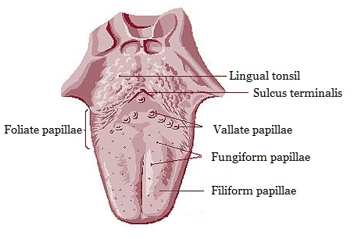
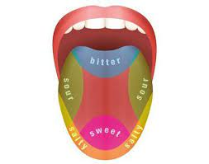
Tongue
Tongue is large muscular, protrusible, mobile and flattened organ.
It lies on the floor of buccal cavity.
It is divided into anterior oval part posterior pharyngeal part.
Upper surface of oval part contain taste buds called papillae. They are of three types:

Slide 46
Vallate papillae: These are large-sized and situated at the base of the oral part of tongue.
Filiform papillae: These are the smallest and most numerous. These are situated near the center part of the tongue.
Fungiform papillae: These are smaller than vallat and less numerous than filiform. They are situated at the tip and the margin of the tongue.

Slide 47
Functions of tongue
It is the organ of mastication, swallowing and speech.
It manipulates the food and mix the saliva with food.
It also acts as a organ of taste

Slide 48
Teeth of human
Teeth are the hard and usually pointed structure connected to the jaw bones in the buccal cavity.
In human beings, the teeth are thecodont ( embedded in the jaw sockets), diphyodont (Originate twice in life) and heterodont (different types of teeth).

Slide 49
Types of teeth
On the basis of structure and function human teeth are of four types:
Incisor: They are present at the front of the mouth cavity. They have flat and sharp and used for cutting and biting food. They contain only one root
Canine: They are present on either side of the incisor. They have pointed dagger-shaped margin. They are used for tearing.
Pre-molars: They are present on either side of the canine. They have a broad margin containing two cusps. These teeth contain one or two roots and are used for grinding food.
Molar: These teeth are also called wisdom teeth. These teeth develop after the age of 16th year. These are present either side of pre-molar teeth. They have broad margin and contain four to five cusps. These teeth contain two or three roots, they are also used for grinding food.

