Slide 1
Chapter 8.2
Kingdom- Animalia

Slide 2
Important terms used in characters and classification of organisms
Cellularity
Unicellular: The organism made up of only one cell is called as unicellular or acellular. e.g. Protozoans.
Multicellular: The organisms made up of many cells are called as multicellular. They are also called metazoans. e.g. All organisms except protozoans.
2. Body layer
a. Diploblastic: The organisms having two germ layers – outer – ectoderm and inner – endoderm. e.g. Sponges and Coelenterates.
b. Triploblastic: The organisms having three germ layers – outer – ectoderm, middle - mesoderm and inner – endoderm.

Slide 3
3. Symmetry
Bilateral symmetry: Body plan is in such a way that when the animal is cut longitudinally and medially, body can be divided into two equal and similar halves. Each half is the mirror image to one another.
Radial symmetry: Body plan is in such a way that when the animal is cut from any sides passing through the central axis, body can be divided into two exact equal and similar halves.
Asymmetry: Body plan is in such a way that when the animal cannot be cut into two equal halves.

Slide 4
4. Habitat
Aquatic: The organisms which live only in water. I. Fresh water: It is the water other than sea or ocean water. II. Marine water: It is the water of sea and ocean.
Amphibian: Those animals which can live both on land and in water. e.g. frog.
Terrestrial: Those animals which live only on land. e.g. man, lizard etc.
Aerial: Those animals which can live in the air. e.g. birds.
Arboreal: Those animals which can live on trees and hold the branches of trees. e.g. monkeys.
Burrowing: Those animals which make burrows in the sand or soil and live inside. e.g. earthworm.

Slide 5
5. Body temperature
Cold blooded (Poikilothermic): Those animals whose body temperature is variable according to the environment. e.g. frog, fish.
Warm blooded (Homoeothermic): Those animals whose body temperature is not variable according to the environment. e.g. birds, mammals.

Slide 6
6. Nutrition
Holozoic nutrition: An organism which takes food in solid form is called holozoic. It is also called animal like.
Holophytic nutrition: It is plant like nutrition. It is also called autotrophs.
Saprozoic nutrition: The animals which feeds on dead organic matter.
Saprophytic nutrition: The plants which feeds on dead organic matter.
Parasitic nutrition: The organisms which live on other organisms and remain alive at the expense of host. e.g. Tapeworm, Liverfluke.
Carnivorous: Those animals which feed on animal flesh. e.g. Tiger, Lion.
Herbivorous: Those animals which feed on plants. e.g. Dear, Cattle.

Slide 7
7. Digestion
a. Intracellular digestion: It is the type of digestion which takes place inside the cell. e.g. Amoeba, Euglena.
b. Extracellular digestion: It is the type of digestion which takes place outside the cell. e.g. Hydra, Earthworm.

Slide 8
8. Respiration
a. Aerobic respiration: It takes place in presence of oxygen.
b. Anaerobic respiration: It takes place in absence of oxygen.

Slide 9
9. Reproduction
Asexual reproduction: It is the type of reproduction in which sexes
are not involved. It takes place by one parent only.
b. Sexual reproduction: It is a type of reproduction in which male and
female sexes are involved. Male and female gametes are fused to
form zygote.

Slide 10
Monoecious or Hermaphrodite or Bisexual= An individual of a species having both the male and female reproductive organs.
Unisexual or Dioecious= When male and female reproductive organs are found in separate individual.
Oviparous= Animals which lay eggs.
Viviparous= Animals which give birth to young ones.

Slide 11
Phylum: Porifera (poros = pore; ferre = to bear)
Characteristics:
a. Multicellular organisms with cellular grade of organization.
b. They are generally sessile (attached to the substratum) in nature.
c. They are exclusively aquatic, mostly marine and few are fresh water organisms.
d. It is also called pore-bearing animals as its body consists of smaller numerous pores through which water current enters into the body is called Ostia and larger with less number of pores through which water current exist out from the body is called Osculum.
e. Nutrition is holozoic with intracellular digestion with the help of coenocytes cells.
f. Water canal system is well-developed.
g. There is absence of circulatory, respiratory and excretory parts.
h. Reproduction both sexual and asexual. Sexual reproduction by copulation where as asexual reproduction by budding or gemmule formation or regenerations.
i. They are hermaphrodite.

Slide 12
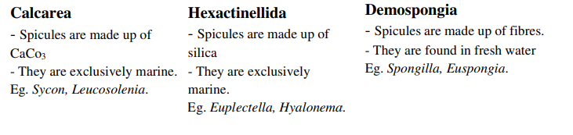
Porifera is divided in to three classes on the basis of chemical nature of spicules:

Slide 13
Phylum: Coelenterata (koilos = hollow; enteron = intestine)
Characteristics:
a. Body possesses an internal hollow cavity known as coelenterons.
b. Multicellular organisms with tissue grade of cellular organization.
c. Radial symmetry with their sessile nature.
d. Exclusively aquatic, mostly marine and few are fresh water organisms.
e. Diploblastic i.e. having two germ layers, outer layer is called ectoderm and inner endoderm. There is non-cellular gelatinous materials in between these two layers are called mesogloea.

Slide 14
f. Mouth is surrounded by short, cylindrical tentacles which help for locomotion, feeding and defence.
g. There is absence of special types of circulatory, excretory and respiratory organs.
h. Digestion both extracellular as well as intracellular.
i. It shows polymorphism or two forms of individuals – asexual form – polyp and sexual form - medusa.
j. Reproduction both sexual and asexual.
k. Sexual and asexual cycle alternates with each other. So it shows alternation of generations or metagenesis

Slide 15
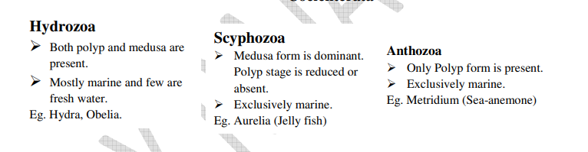
On the basis of presence and absence of reproductive forms (polyp and medusa) coelenterates are divided into three classes.

Slide 16
Phylum: Platyhelminthes (Platy= flat; hlminthes = worm)
Characteristics
The body is dorso-ventrally flattened leaf-like. They are called as
flatworms.
b. They are mostly parasites. Some are free-living as planaria.
c. They are triploblastic and bilaterally symmetrical.
d. They are acoelomate animals. The space between body wall and the
internal organs is filled up with parenchyma.
e. Parasite animals develop adhesive structures like hooks, spines, and
suckers which enable the parasite to remain attached to body parts.

Slide 17
f. Nutrition is holozoic type.
g. Digestive system is incomplete and branched or absent. Anus is absent.
h. Respiratory organs are absent. They perform anaerobic type of respiration.
i. They have an excretory organ flame cell or protonephridia. Excretory pore is present as a posterior end.
j. The reproductive system is well-developed and complex. They are hermaphrodite, bisexual, or monoecious.
k. Fertilization may occur internally, cross or self. However, parthenogenesis or polyembryo commonly occur in parasitic forms.
l. Life cycle is simple or complex. It may require one host (monogenetic) or two host (digenetic)

Slide 18
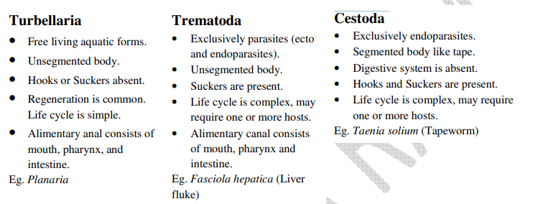
Platyhelminthes is classified into three classes on the basis of habitat and segmentation.

Slide 19
Phylum: Nemathelminthes (nematos = thread; helminthes = worm)
Characteristics:
a. These are cylindrical, elongated, unsegmented and worm-like.
b. These are mostly parasitic and some are free-living found in soil and water.
c. They are triploblastic.
d. They are bilaterally symmetrical.
e. Nutrition is holozoic type.
f. Alimentary canal is complete and straight.
g. It consists of lateral excretory ducts which collect the excretory substances and expel out through the anus.
h. These are unisexual or dioecious.

Slide 20
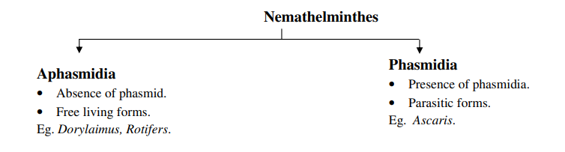
On the basis of presence and absence of caudal sense organ (phasmid), phylum, nemathelminthes is divided in two classes.

Slide 21
Phylum: Annelida (annulus = ring; eidos = form
Characteristics:
a. They are elongated and metamerically segmented.
b. They are mostly aquatic and some are terrestrial and burrowing, Few are
ectoparasites sucking the blood from vertebrates.
c. They are triploblastic.
d. They are bilaterally symmetrical
e. Coelom is true coelom type. Formed by mesoderm. Such coelom is called chizocoel.
f. Locomotion takes place by setae (in Earthworm) or parapodia (in Nereis) or suckers (in Leach).

Slide 22
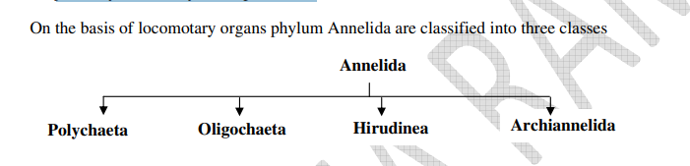
g. Nutrition is holozoic type.
h. Respiration takes place through moist body surface by diffusion.
i. Excretion takes place through segmentally arranged nephridia.
j. They are usually hermaphrodites.

Slide 23
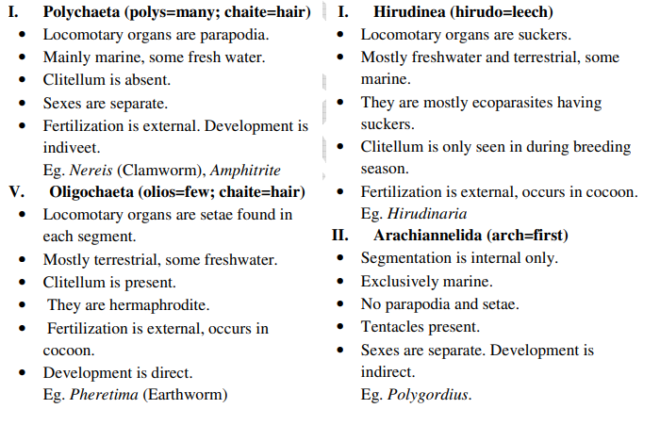

Slide 24
Phylum: Arthropoda (arthron=jointed; podos = Irgs)
Characteristics:
a. Body consists of jointed appendages or legs.
b. This is the largest phylum. The animals of this group are found in all the habitats.
c. These are triploblastic and bilaterally symmetrical.
d. The body is covered externally by the hard chitinous exoskeleton.
e. Body is divisible into head, thorax and abdomen. In some, head and thorax is often fused to form cephalothoraxes as in prawn.
f. A true head in present. It bears a pair of compound eyes, antenna, and feeding apparatus.
g. Locomotion takes place by paired lateral jointed appendage.
h. Alimentary cannel is straight and well developed.

Slide 25
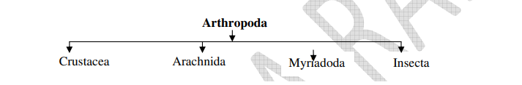
On the basis of no. of legs and body condition phylum Arthropoda is divided into four classes.

Slide 26
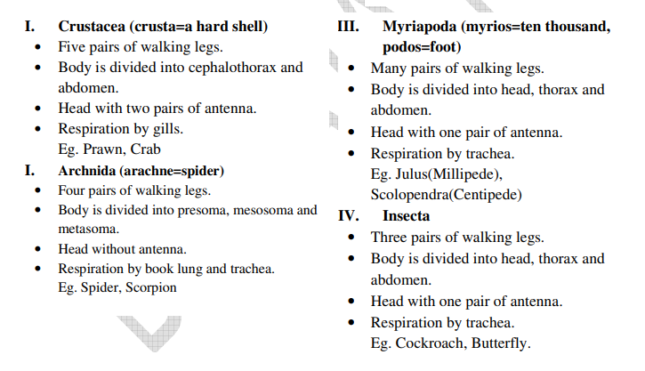

Slide 27
Phylum: Mollusca (molluscus = soft)
Characteristics:
a. Body is soft and unsegmented.
b. They are mostly freshwater or marine and few are terrestrial living in damp place.
c. Triploblastic and bilaterally symmetrical body except in gastropods (body asymmetry).
d. There is the presence of a hard, protective, calcareous covering of the body is called the shell which forms the exoskeleton of the body.
e. Body is divisible into head, mantle, visceral mass and foot.
f. Sense organs are eyes, tentacles, osphradium(water testing organ), statocysts(organ of equilibrium) etc.

Slide 28
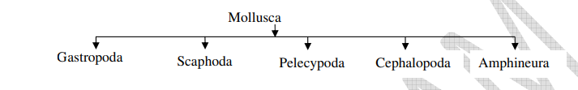
g. Respiration with the help of ctenidia or gills in aquatic environment and pulmonary sac for terrestrial environment.
h. Mostly unisexual and external fertilization.
On the basis of structure and function of foot, phylum mollusca is divided into five classes.

Slide 29
Gastropoda (gater=belly; podos=foot):
• Foot generally flat types and help in creeping movement.
• Body covered by hard shell.
• Body asymmetry.
• Marine, freshwater and terrestrial.
Eg. Apple snail (Pila), Garden snail (Helix), Slug.
Scaphoda (scapha=boat; podos=foot):
• Foot generally pointed and help for burrowing (digging).
• Body covered by a hard shell.
• Bilateral symmetry.
• Exclusively marine.
Eg. Dentalium

Slide 30
Pelecypoda (pelekus=hatchet; podos=foot):
• Foot generally hatched shaped and help for digging.
• Body is covered by shell with two valves.
• Bilateral symmetry.
• Eg. Unio
Cephalopeda (kephale=head; podos=foot):
• Foots are modified into arms with suckers.
• Bilateral symmetry.
• Marine or freshwater.
Eg. Octopus, Sepia.
Amphineura (amphi=both; neuron=nerve):
• Foot generally flat and help during creeping
• Bilateral symmetry.
• Marine or freshwater.
Eg. Chiton

Slide 31
Phylum: Echinodermata (mechinos=spine; derma=skin)
Characteristics:
a. Body is covered with spines.
b. Exclusively marine so they are not found in Nepal.
c. Body triploblastic and radially symmetrical.
d. Head is not distinct. So body is divisible into oral and aboral ends.
e. Locomotion with the help of tube feet.
f. Presence of water vascular system is the important characteristics of
echinoderms which help for circulation, respiration, feeling and excretion.
g. There is absence of excretory organ.
h. They are unisexual.

Slide 32
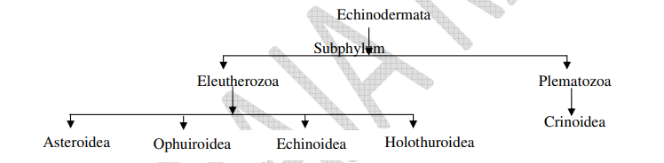
On the basis of number and type of arm and form of the body phylum echinodermata is divided into five classes.

Slide 33
Asteroidea:
• Body is star shaped having five radiating arms, which are not separated from the central disc.
• Oral and aboral surfaces are distinct.
Eg. Asterias (Starfish)
Ophuivoidea:
• Body is star shaped having five radiating arm which are distinctly separated from the central disc.
• Ambulacral grooves absent or covered with ossicles.
Eg. Ophioderma.
Echinoidea:
• Body generally circular without arms.
• Ambulacral grooves covered with ossicles
Eg. Echinus

Slide 34
Holothuroidea:
• Body is generally elongated without arms and spine.
• Mouth surrounded by tentacles.
Eg. Holothuria (Sea cucumber)
Crinoidea:
• Body is more or less circular without arms.
• Ambulacral grooves and scattered ossicles.
Eg. Antedon.

Slide 35
Phylum: Chordata
Characteristics:
a. Presence of notochord at some stage of development.
b. Present of dorsal tubular nerve cord.
c. Present of gills slits (gill opening) on either side of the pharynx at some stage of the development.
d. A well-developed coelom.
e. A ventrally situated heart.

Slide 36
Three important characters of phylum chordate are:
1. Notochord: (noton=back; chorda=a cord): Notochord is a stiff, solid rod like structure that provides internal support. It is situated between the nerve cord and alimentary canal. It is present either embryonic stage or throughout the life. Later on it is replaced in an adult by ossified vertebral column or back bone.
2. Nerve cord: It is tubular nerve tissue. It is situated dorsally above the notochord. Later on it is replaced into central nervous tissue. i.e. brain and spinal cord.
3. Gill slits: These are the paired lateral gill openings situated on both side of pharynx. These are the respiratory openings which take part in exchange of gases. These are present in fishes throughout the life in other higher vertebrates, gills slits seen during embryonic stage only.

Slide 37
