Slide 1
Introduction to Biology

Slide 2
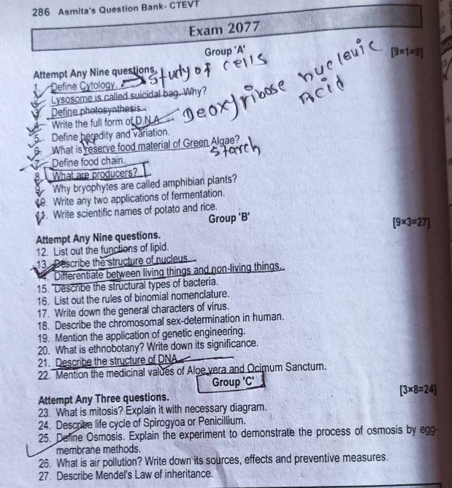

Slide 3
Definition
Botany is the branch of Biology that deals with the study of plants.
Theophrastus is known as the Father of Botany

Slide 4
Branches of Botany
Morphology: Study of external structure of any organism.
Anatomy: Study of internal features of any organism.
Physiology: Study of life processes of any organism.
Paleontology: Study of fossils.
Pedology: Study of soil.
Bryology: Study of bryophytes
Pteridology: Study of pteridophytes
Pomology: Study of fruits and fruits yielding plants

Slide 5
Horticulture: Study of cultivation of plants for flower
Floriculture: Study of cultivation of plants

